Slide 1











Survive, Thrive, Transform:
Nurturing care for early childhood development

Slide 2




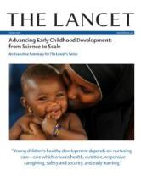
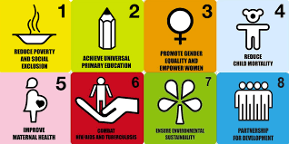
The unique convergence of evidence and political momentum for ECD
WHO Commission on Social Determinants
of Health 2008
2015
2005
ECD Lancet series 2007
ECD Lancet series 2011
2000

Slide 3

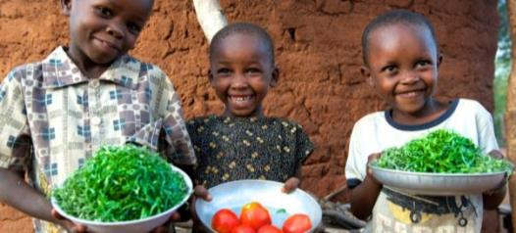
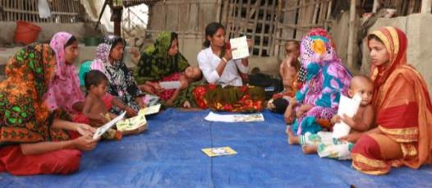
The global strategy for women’s, children’s and adolescents’ health 2016 - 2030
1. SURVIVE
  End preventable deaths
2. THRIVE
  Ensure health and well-being
3. TRANSFORM
  Expand enabling environments

Slide 4

The Lancet series key messages
The first 1000 days, starting from conception, are a period of special sensitivity for child development
The most formative experiences of young children come from NURTURING CARE
Early investment is essential and benefits are lifelong and intergenerational
The cost of inaction is huge
Policies, information and services are essential to create enabling environments
Multisectoral collaboration is essential and the health sector has a special role to play

Slide 5

The Nurturing Care Framework launched at the time of the 71st World Health Assembly in 2018
A road map that outlines:
Why efforts must begin in the earliest years, from pregnancy to age 3
How nurturing care protects children from the worst effects of adversity
What caregivers need in order to provide nurturing care

Slide 6
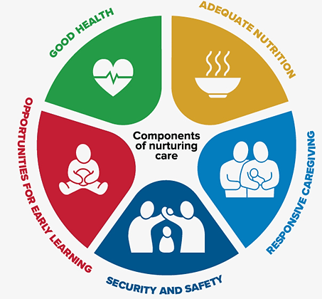
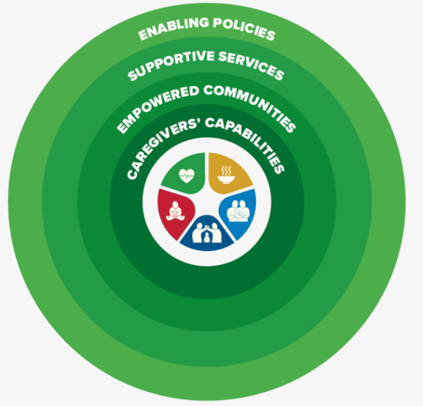
Two interrelated action areas
What the child’s brain
expects and needs
Enabling environments for nurturing care

Slide 7
Who is the framework for?
Health and Nutrition
Environment, WASH
Education
Social Welfare
Child protection
National policy makers, programme managers
Service providers, education institutions, professional associations, academia
Parliamentarians, community leaders
Civil society groups, development partners, funding initiatives
Private sector, media
Families, parents and other caregivers

Slide 8

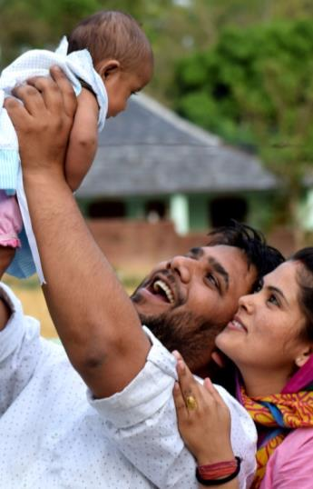
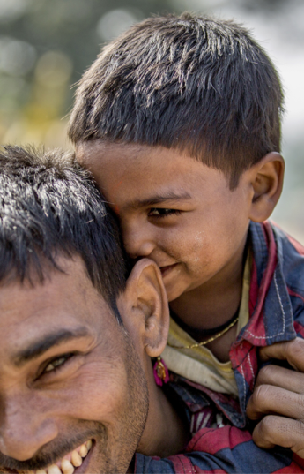
The vision
A world in which every child is able to develop
their full potential and no child is left behind

Slide 9
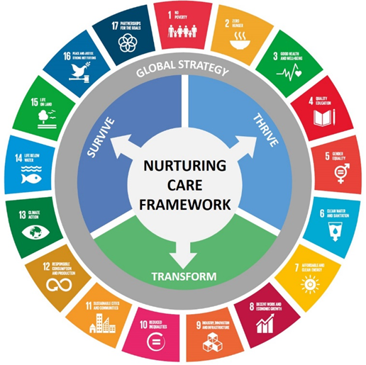
Five targets aligned with SDGs
  Goal 1, target 1.2: By 2030, reduce at least by half the proportion of men, women and children living in poverty
  Goal 2, target 2.2: By 2030, end hunger and ensure access by all people to safe, nutritious and sufficient food all year round
  Goal 3, target 3.2: By 2030, end preventable deaths of newborns and children under 5 years of age
  Goal 4, target 4.2: By 2030, ensure that all girls and boys have access to quality early childhood development, care and pre-primary education
  Goal 16, target 16.2: By 2030, end abuse, exploitation, trafficking and all forms of violence against and torture of children

Slide 10

Enabling policies
To provide caregivers with time and resources
Maternity protection
Code of marketing of breastmilk substitutes
Baby-friendly hospital initiative
Breastfeeding breaks at work
Parental leave
Cash transfers
Health insurance
National minimum wage
Child and family social protection
Affordable child care
Free pre-primary education

Slide 11

Effective interventions across the life course
Health and nutrition
Maternal nutrition
Family planning
Prevention of substance abuse
Antenatal care
Child birth care
Essential newborn care
Breastfeeding
Complementary feeding
Immunization
Management of childhood illness
Care for maternal mental health
Care for children with developmental difficulties
Security and safety
Birth registration
Safe water and sanitation
Good hygiene
Clean environments
Clean air
Safe places for recreation
Prevention of violence
Cash transfers
Social care
Responsive caregiving and early learning
Skin-to-skin contact after birth
Kangaroo mother care for small babies
Responsive feeding
Play and communication
Home made toys
Book sharing
Father’s involvement in child care
Quality child care
Using local language
Indigenous practices

Slide 12


Slide 13
WHO/UNICEF Care for Child Development

Slide 14
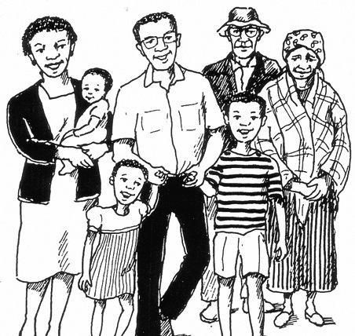
Optimizing contacts in (health) services
Antenatal consultation
Maternity ward
Postnatal consultation
Well-baby consultation
Sick child consultation
PMTCT services
Nutrition rehabilitation
Pediatric inpatient care
Waiting room talks and play boxes
Mother groups
Child care centers
Faith-based activities
Social protection schemes

Slide 15

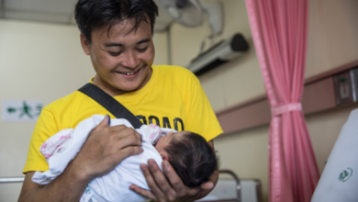
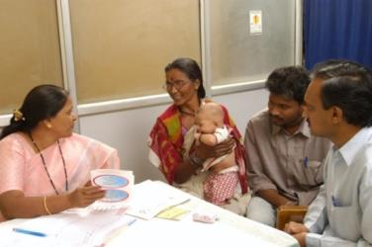
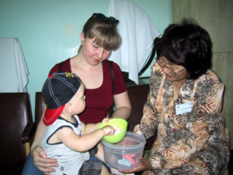
Doing things differently
Services that:
address all five domains of nurturing care
consider the needs of caregivers and the child
ensure the continuum from first to referral levels
are connected across sectors
Engaged communities

Slide 16
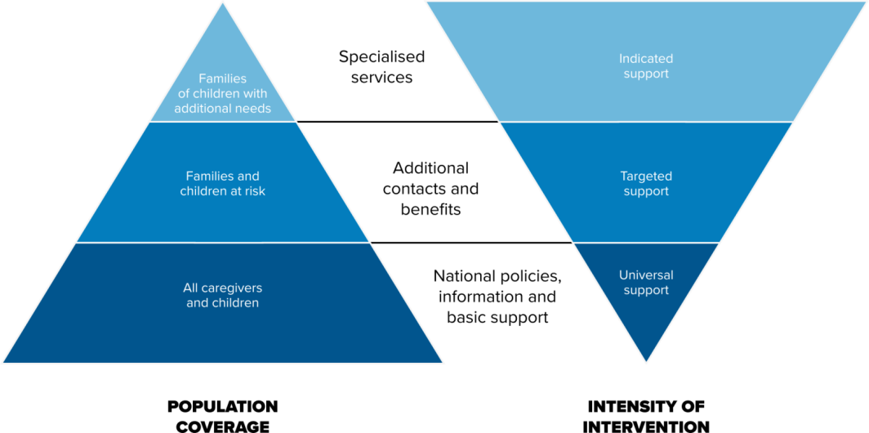
Meeting families’ and children’s needs

Slide 17



Maternal mental health
No health without perinatal mental health, The Lancet 2014
Prevalence of antenatal common mental disorders: 15.9% (95% CI: 15.0–16.8%)
Prevalence of postpartum common mental disorders: 19.8% (95% CI: 19.2–20.6)
Effect on maternal health: poor obstetric outcomes, suicide
Effect on child health: preterm birth, low birth weight, delayed initiation of breastfeeding, malnutrition and stunting, non-completion of immunizations, higher rates of childhood illnesses, impaired development/behaviour problems

Slide 18
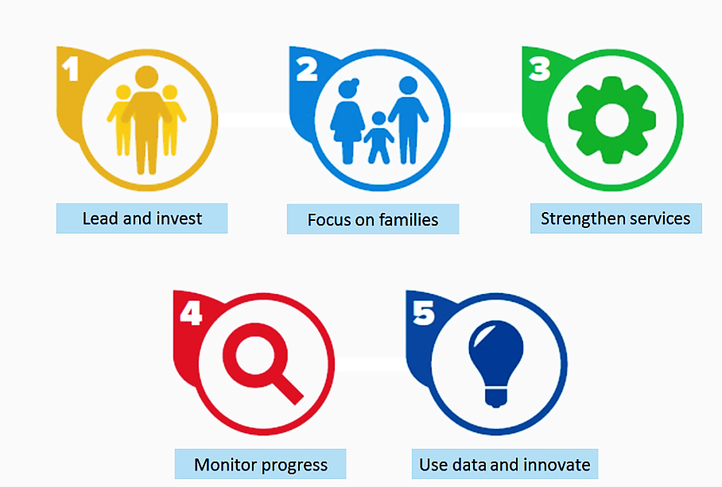
Five strategic action areas for moving forward

Slide 19
Uptake of the Nurturing Care Framework (June 2019)

Slide 20


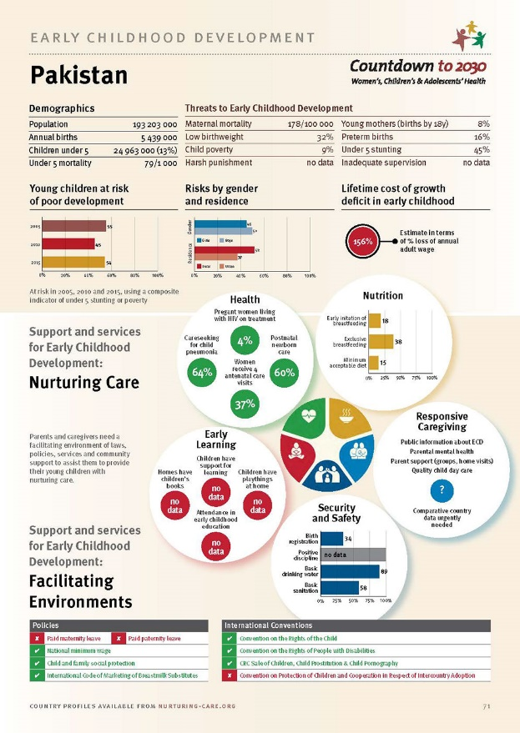
Monitoring progress
Demographics
Threats to child development
Young children at risk
Lifetime costs of poor growth
Facilitating environment
  Policies to support families
Nurturing care components
  Health, nutrition, security & safety, responsive caregiving, opportunities for early learning

Slide 21







http://www.nurturing-care.org
http://www.ecdan.org

Slide 22
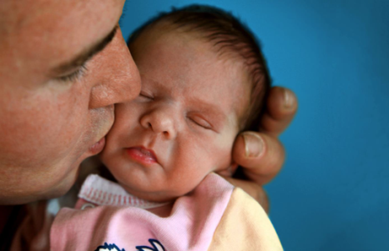
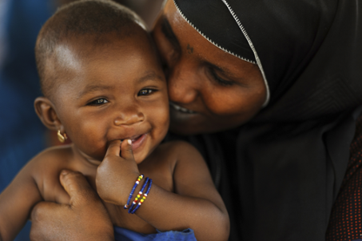

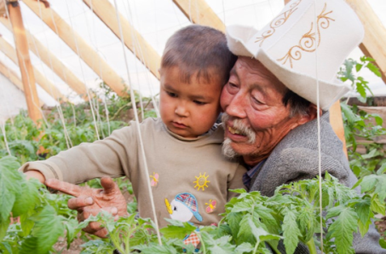

Thank you

