Slide 1
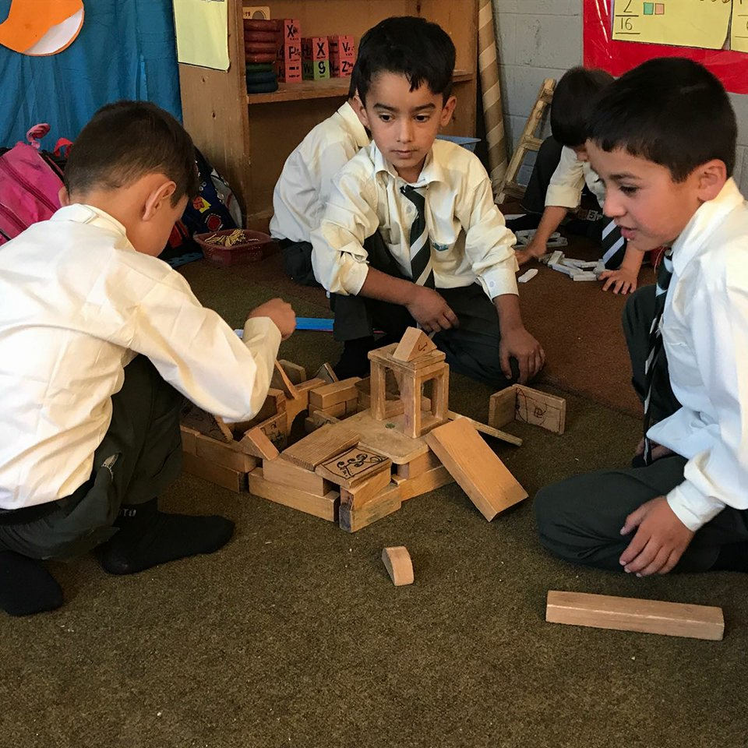
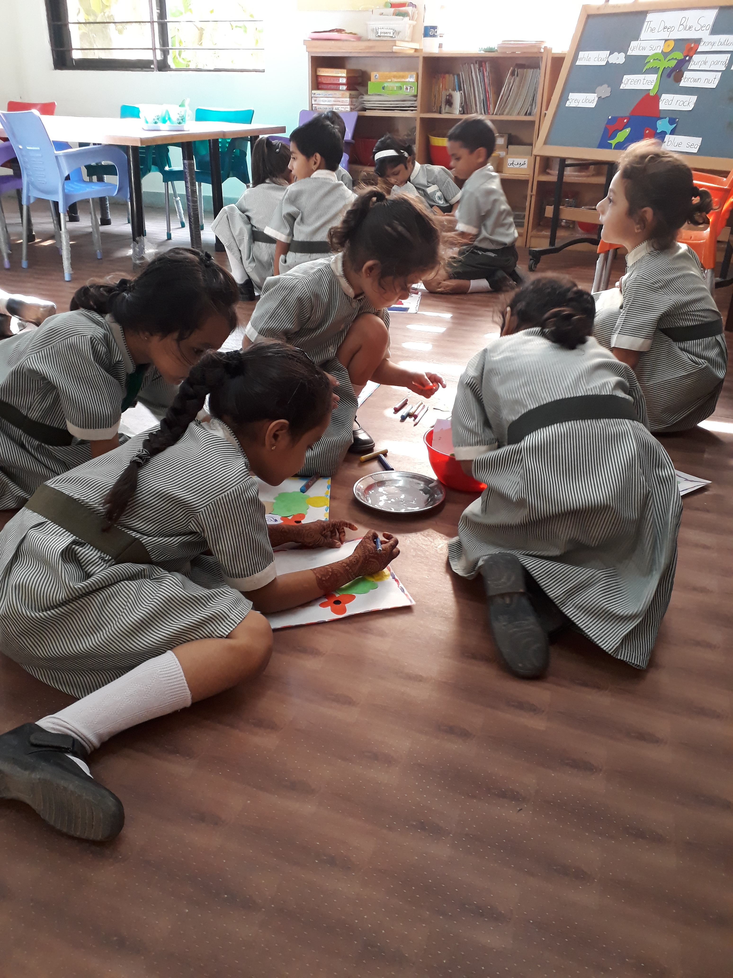
AKES Pakistan - ECD programmes

Slide 2
Past
Grade | Age group (at entry level)
ECD 1 | 3 year old and above
ECD 2 | 4 year old and above
ECD 3 | 5 year old and above
ECD 4 | 6 year old and above

Slide 3
Present
Grade | Age group (at entry level)
Pre-primary 1 | 2-3 year old children
Pre-primary 2 | 3-4 year old children
Pre-primary 3 | 4-5 year old children

Slide 4
Programmes
MLS aligned with NC
High Scope Approach
Standardized learning materials
Standardized ECD Foundation Course
Others:
GGA
ASQ

Slide 5
Demographic information
Region |  | Total # of schools | Pre-primary provision | Break up
 |  |  |  | PPI | PP II | PPIII
Chitral | Schools | 43 | 40 | 0 | 14 | 40
 | Enrolment |  | 1310 | 0 | 355 | 955
Gilgit Baltistan | Schools | 104 | 104 | 2 | 73 | 104
 | Enrolment |  | 4136 | 59 | 1872 | 2205
South | Schools | 7 | 7 | 4 | 7 | 7
 | Enrolment |  | 1301 | 201 | 504 | 596
Total | Schools | 154 | 151 | 260 | 2731 | 3756
 | Enrolment |  | 6750

Slide 6
targets (2019-2021)
Region |  | Total # of schools | Break up
 |  |  | PPI | PP II | PPIII
Chitral | Schools / sections | 43 | 0 | 62 | 3
 | Enrolment |  |  | 1550 | 75
Gilgit Baltistan | Schools /sections | 104 |  | 31
 | Enrolment |  |  | 775
South | Schools / sections | 7
 | Enrolment
Total | Schools / sections | 154
 | Enrolment |  |  | 2325 | 78

Slide 7
Human Resources
ECD Coordinators | 3
ECD Educators | 10
ECD Teachers | 275
Total | 288

Slide 8
Our Current Approach: High Scope
Daily Routine (8:00-12:00) PP-II (3 hours & 30 mins) | Daily Routine (8:00-12:00) PP-III (4 hours)
Large circle time -15mins Reading time -20mins Concept Time (English/Urdu)– 40mins Plan-Do-Review – 45mins Snack Time-30mins Out door Time – 25mins Concept Time (Numeracy)-40mins Farewell time – 5mins | Large circle time -15mins Reading time (Eng/Urdu)-20mins Concept Time (English)– 40mins Plan-Do-Review – 45mins Concept Time (Urdu)- 40mins Snack Time-30mins Out door Time – 25mins Farewell time – 5mins

