Slide 1
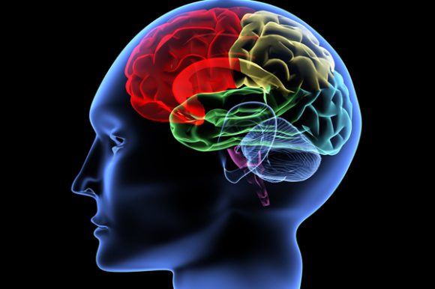
Potential Interventions for Optimum Brain Development in Early Years
Consultative Workshop- ECDNP
March 27, 2018
Aneela Altaf Mukhi PhD in ECD (Student)
Freelance Consultant - Early Childhood Development

Slide 2
Today’s Session
How Brain Develops
How to support Brain Development
Impact of toxic stress on brain development
Global best practices in ECD
Principles for sustainable ECD endeavours

Slide 3
http://mbi.ufl.edu/brain-initiative/
Notes:
This activity will help participants to think about what they might already know or think they know about brain development. Be prepared to answer some questions and to indicate what participants will learn during discussions in the session. See the SECD Resource Kit for details.
Let participants know that over the next five slides there are statements that they will be asked whether they believe to be true or false. Ask participants to keep standing if they think the statement is true, and have a seat if they think it is false.

Slide 4
Did you know?
Did you know …..
…a human brain is the most complex and profound object in the universe.
…the galaxy has 100 billion stars and a human brain has 100 billion neurons.
stardustobservatory.org
Notes:
The brain is an amazing organism. The adult human brain is a 1400 gram organ (about 3 pounds) and is the size of your two fists put together. A newborn's brain is about 25 percent of its approximate adult weight. But by age 3, it has grown dramatically by producing billions of cells and hundreds of trillions of connections, or synapses, between these cells.
Our brain controls almost everything we do and are. Scientists still have much to learn about how the brain works but they have discovered just how complex it is.

Slide 5
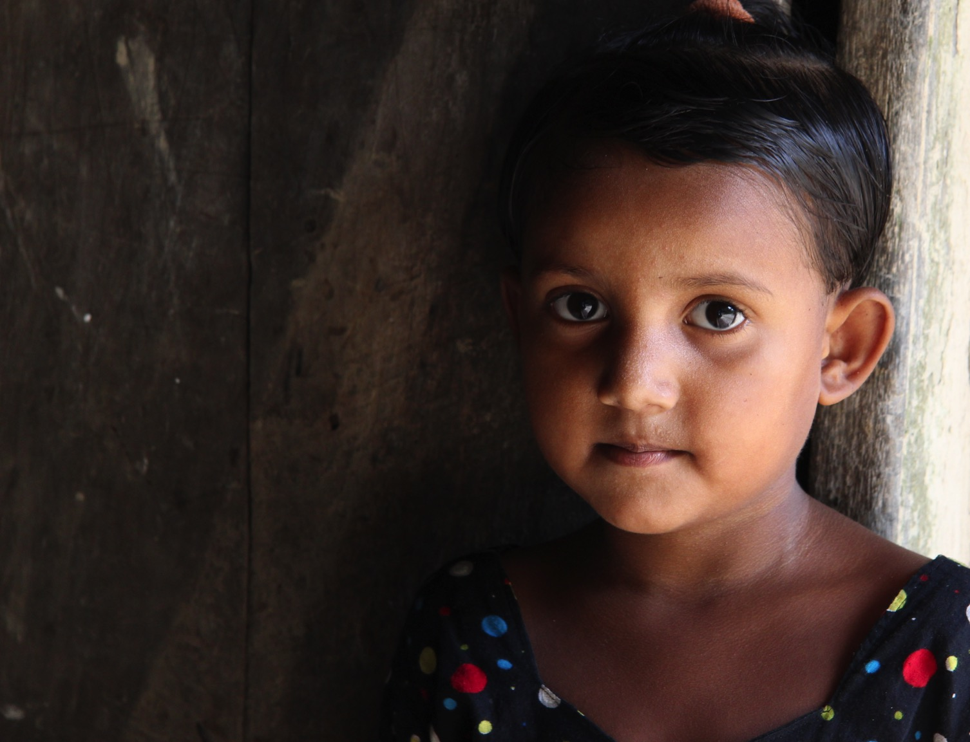
Every child is born
with enormous potential.
Notes:
Four-year-old Rina lives in a village near Sylhet, in northern Bangladesh. Rina is playful, eager to learn and very curious about the world around her Rina has learned a great deal in her short lifetime. She has changed immensely since her birth and seems like almost an entirely different creature from the tiny baby she was. She can walk, run, play, speak two languages, help with simple chores, has an imagination and a lively, mischievous personality.
Rina’s highly active brain is building neural circuits for life that are shaped by her genes and her environment. We now know that the human brain is very reactive, particularly early in life. Our earliest experiences of childhood influence early brain development and reach long into adulthood. At the same time, our brains remain open to environmental influence as long as we are alive.
Understanding how the brain develops helps us to see the enormous potential of each child and the relative simplicity of what it takes to help children thrive – with long lasting effects.

Slide 6
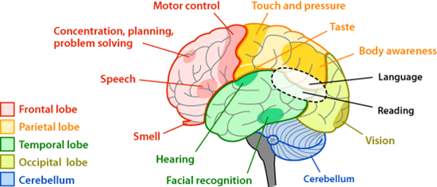
Did you know?
stardustobservatory.org
Notes:
Here’s another way to look at it.
Source: https://askabiologist.asu.edu/sites/default/files/resources/articles/nervous_journey/brain-regions-areas.gif

Slide 7
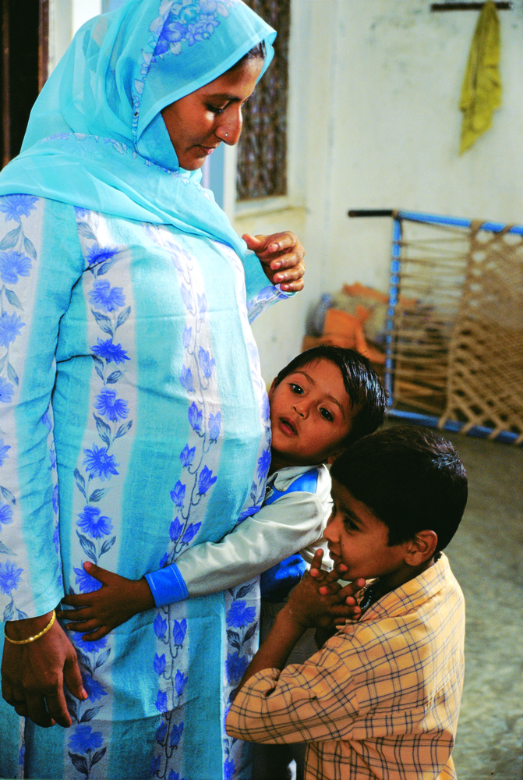
The brain is developing before we are born.
Notes:
Brain development begins well before a child is born. Experiences in the womb can strongly influence brain development. Women need to be supported not only during pregnancy but even earlier

Slide 8
It is the minute-by-minute, day-by-day events of nurturing that shape early brain development.
Notes:
The caregiving a baby experiences influences their brain development. We now understand that everyday experiences are very important for nurturing brains. Everyday life shapes brain development. What parents and caregivers naturally do when they interact with babies really helps to support healthy brain development. This helps us to understand that whether we are feeding the child, playing with the child or rocking the baby to sleep, we are contributing to brain development. We get a chance to see everyday interactions and consider their impact through the next two slides.

Slide 9
`Sensitive periods’ in early brain development
“Pre-school” years
School years
High
`Numbers’
Peer social skills
Sensitivity
Symbol
Language
Habitual ways of responding
Emotional control
Vision
Hearing
Low
Adapted from Nash, 1997; Early Years Study, 1999; Shonkoff, 2000
0
1
2
3
4
5
6
7
Years
Notes:
Although Kolb uses the expression ‘critical’ periods, the preferred terminology is ‘sensitive’ periods. Sensitive periods refer to times when the brain is particularly ready to form connections related to a specific function. During these periods, the brain is especially responsive to whatever input it does (or does not) receive from the surrounding environment. However, the brain does continue to develop these functions all through life – therefore the term critical (which implies ‘now or never’) is inappropriate.
Neurons connect with each other to create neural circuits or pathways for functions such as seeing, hearing, thinking, moving, talking - and much more - early in life. Not all neural pathways are constructed at the same time.
As you go through this slide, look carefully at when the development of neural pathways for different functions are most active.
Click through the slide. As you go through, point out – or have participants point out when different aspects of brain development are most active. Encourage them to think about how children behave at these times. E.g. ….
Have you ever noticed how a young baby starts trying to pick up tiny specks off the floor when they are about 8 months old – and really notice things that are some distance away? You can see that their vision is really developing at about this time.
Notice that language (both understanding and expressing) peaks around the ages of 2 to 4 and remains active into middle childhood. How do you see this in children?
Habitual ways of responding refers to how responsiveness to challenges, novelty, stimuli - response patterns that become automatic, some say part of the unconscious. For example, some of us tend to respond more intensely to things such as a sudden, loud noise for example, than others. One baby may startle and then cry for quite awhile while another may startle but become calm again quite quickly.

Slide 10
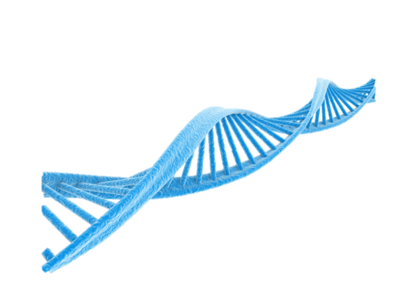
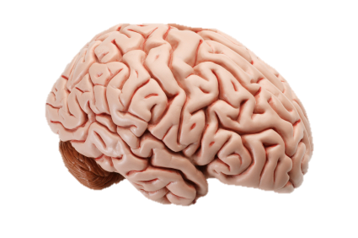
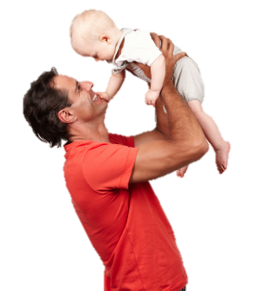
Experience-based brain development
genes
brain
learning
health
epigenetics
behaviour
experience
physical environment
nurturing
nutrition
Notes:
This slide provides a graphic overview of how experience is completely intertwined with our genetic makeup to affect brain development – and who we are. Listen carefully as the story unfolds.
Narrate as animation progresses from left to right as below:
Left graphic: Robust research from many perspectives concurs that early human development is an intricate dance between nature and nurture, genes and environment. Genes listen to the environment and the environment adapts the genetic blueprint. In early life, nurturing, stimulation and nutrition interact with genetic predispositions to sculpt the architecture of the brain and its neural pathways, influencing learning, behaviour and physical and mental health for life.
Our genetic inheritance is a blueprint for development as a unique human being. All cells growing from a fertilized egg contain the same DNA.
Our genes listen to the environment and cells differentiate for their diverse functions throughout the body. Nurturing, stimulation and nutrition interact with genetic predispositions..
Experiences leave a chemical signature or epigenetic mark that sits atop the of the genes and can determine whether and how the genes are switched on and off. Epigenetics alters genetic expression without changing the DNA sequence. Many of these changes are temporary but others seem to be enduring. The DNA blueprint now carries a personalized signature.
Middle graphic: The architecture of the brain is directed by gene-environment interactions. The wiring and sculpting of billions of neurons for sensory and regulatory neural pathways begin before birth and is very active during early infancy. Language pathways are under construction from early life through middle childhood. Neural pathways for cognitive functions also begin in the early years and extend into adolescents and early adulthood.
Right graphic: The brain’s neural pathways, shaped by the gene-environment interaction, influence learning capacity, behaviour and physical and mental health for life.

Slide 11
A child’s brain has 10 times more connection than entire internet

Slide 12
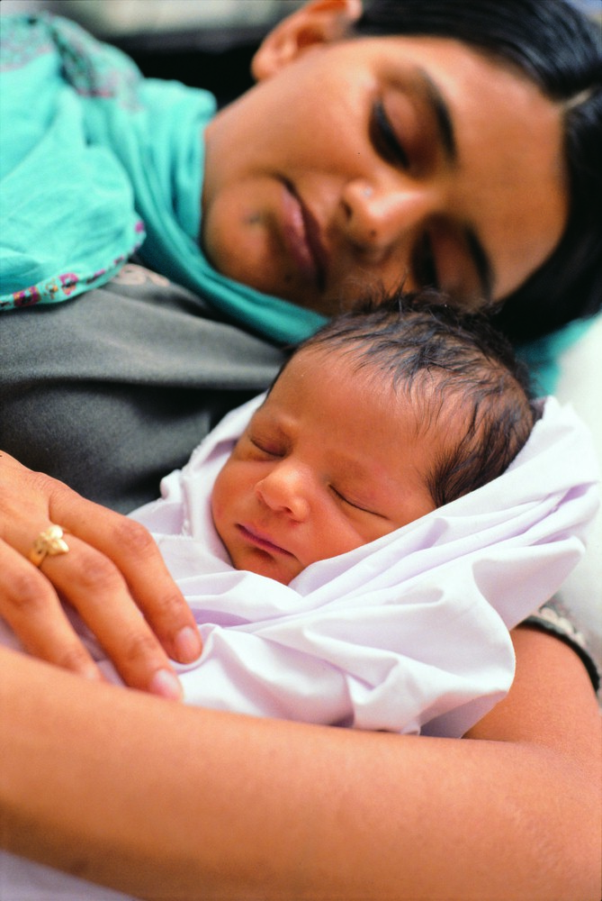
The power of responsive care
Notes:
In humans the epigenetic evidence is more complex and multiple suites of genes may be affected by certain experiences. A lot of work has been done on the effects of chronic stress and its interaction with different genetic types. It has been found that some children are much more vulnerable to the effects of stress than others but in general, chronic stress in early life results in people who find it more difficult to learn, are more jittery and also more prone to addiction as their systems are set to be reactive to outside threats. It has been found that responsive care in the first few years is a highly effective buffer against stress. Children who are loved, nurtured and stimulated – held, talked to, noticed and responded to – can develop very well even if they are living under challenging circumstances. (You will learn more about this in the Coping and Competence module. )The key point is that experiences such as nurturing responsive care (or lack of it) become biologically embedded (under the skin) and leave a chemical signature at a cellular level which has long term effects on our learning capacities, behavour and physical and mental health. Recent research has shown that biologically embedded experiences can not only a lifetime but can even be passed down through generations.
What affirmation does the epigenetics research provide to those of us concerned with maternal child health and early child development?
How might you be able to use it in your context?

Slide 13
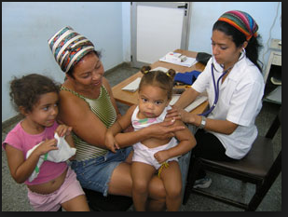
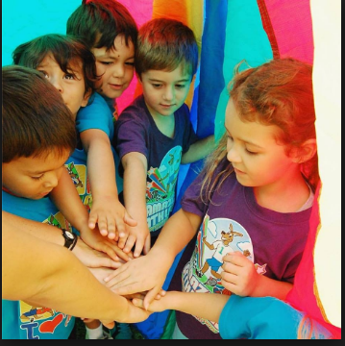

Slide 14
Family is the centre piece of Cuban system.
They are equipped with skills to care, stimulate and nurture children.
Integrated services of health, education, culture in a non institutional environment.
Risk prevention and early detection through regular check ups.
Attention to diversity eg. Children of prisoners visit their parents with caregivers

Slide 15
Satellite Kindergarten Education Project – Kyrgyz Republic

Slide 16
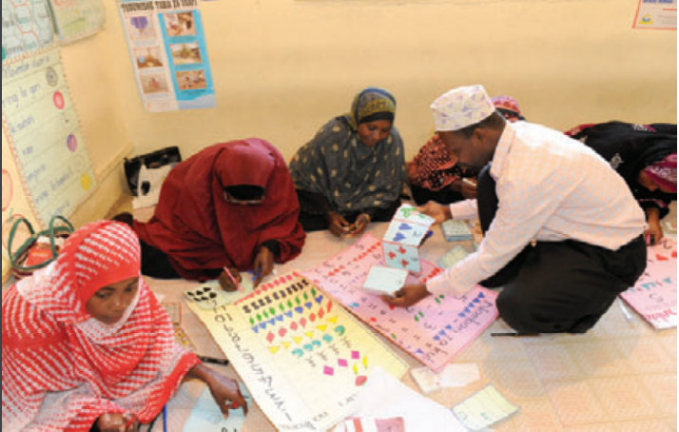
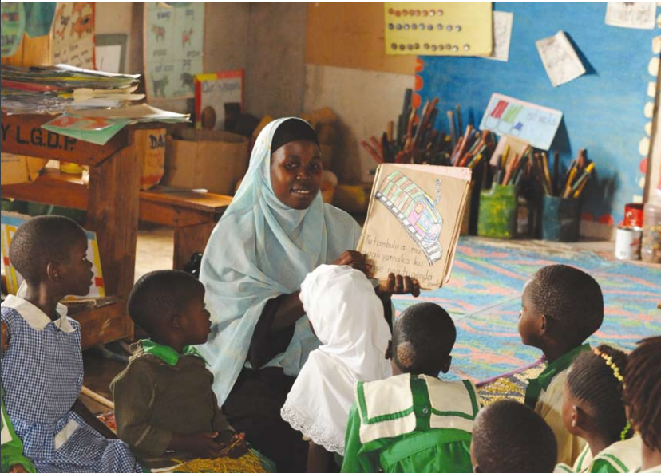
Madrasa ECD Programme of Aga Khan Foundation-
East Africa

Slide 17
Success towards sustainable ECD is just 5 steps away…

Slide 18
Developmentally appropriate practice in context
Policies, goals and designing desired approach
Integrated approach to service delivery/ Cross institutional synergy among various sectors
Effective Leadership and Management of service delivery
Partnership-Public, Private and Civil Society

