Slide 1
CONSULTATIVE SESSION ON EARLY CHILD DEVELOPMENT
NURTURING CARE TRENDS IN THE WORLD

Slide 2
What has the world done to support ECD

Slide 3
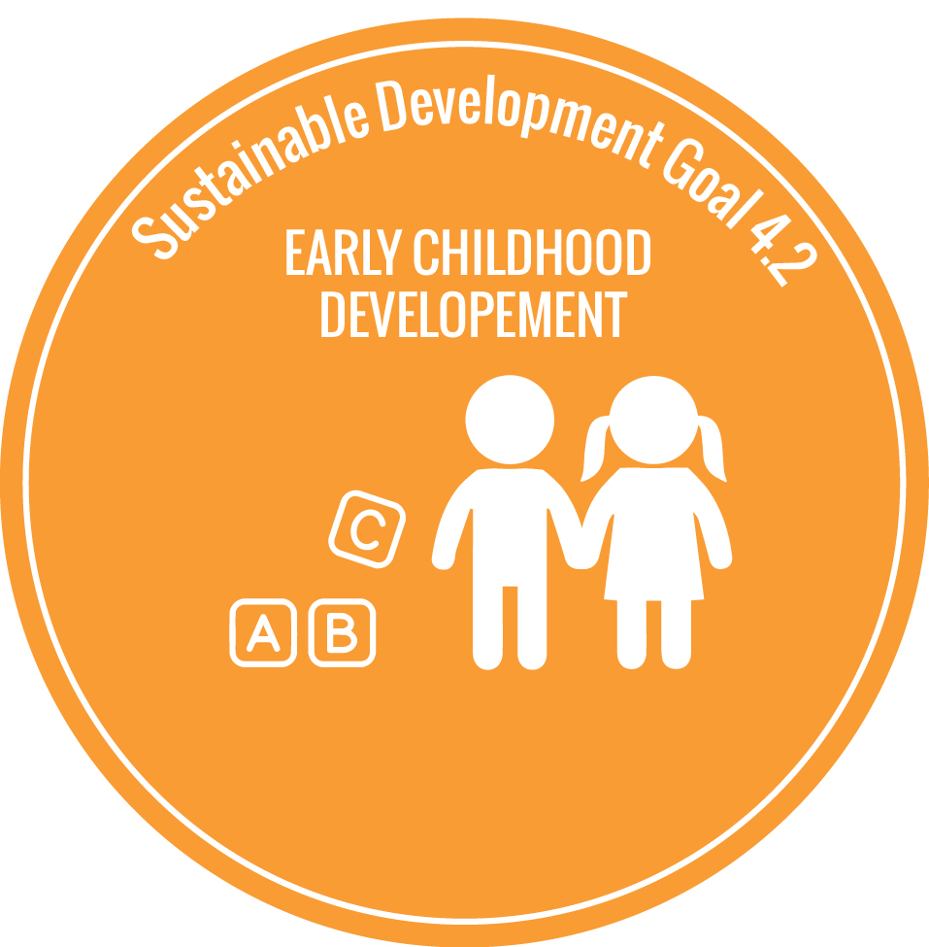
Global Progress on ECD
SDG Target 4.2
Ensure that all girls and boys have access to quality early childhood development, care and pre-primary education by 2030
MDGs, last set of global development goals, had no representation of ECD except for infant mortality and maternal mortality
SDGs provide unprecedented opportunity to scale up early childhood education

Slide 4
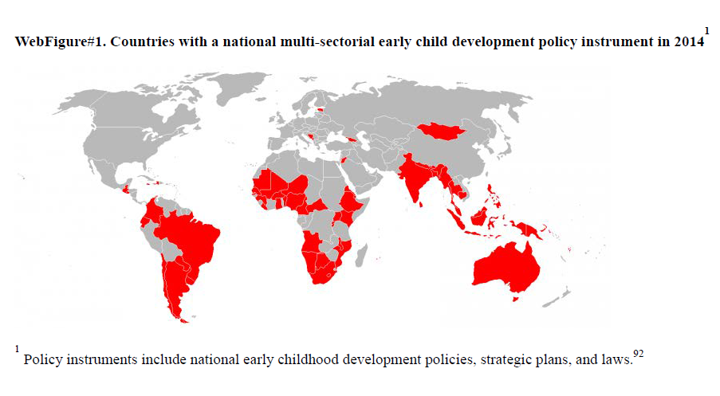
2000
7 countries
2007
40 countries
2014
68 countries
Countries with a national multi-sectoral early childhood development policy instrument in 2014

Slide 5
What is the state of the world's young children right now?

Slide 6
Children at Risk
220 million children under the age of five worldwide are either stunted or are living in extreme poverty
17,000 children under the age of five are dying every day, about half of these deaths occur in just five countries: India, Nigeria, Pakistan, Republic of Congo, and China
Pakistan has the third highest rate in the world where under-5 stunting rate was 44% in 2016 and 34% in 2017 (UNICEF)

Slide 7
Societal cost of not reducing stunting
Region | Country | GDP/capita US$ | Govt health expenditure (%GDP) | Cost of inaction (%GDP)
Sub-Saharan Africa | Ethiopia | 505 | 1.8 | 7.9
 | Kenya | 1245 | 1.8 | 5.4
 | Madagascar | 463 | 2.5 | 12.7
 | Nigeria | 3005 | 1.9 | 3.0
 | Tanzania | 695 | 2.8 | 11.1
 | Uganda | 572 | 1.9 | 7.3
South Asia | Bangladesh | 1.2 | 1.2 | 5.6
 | India | 1.3 | 1.3 | 8.3
 | Nepal | 2.2 | 2.2 | 3.4
 | Pakistan | 1.0 | 1.0 | 8.2

Slide 8
Looking beyond risks of poverty & stunting
Both low maternal schooling and child maltreatment are related to poor child outcomes
When you add these factors, risk for poor outcomes increases dramatically
From 62.7% for stunting and extreme poverty
To 75.4% with the other risk factors added

Slide 9
Accumulation of adversity
Poverty
Nutritional deficiencies
High-crime communities
Low-quality resources
Family stress
Child abuse and neglect
Food insecurity
As the number of risk factors increases, the severity of impact rises
Children in LMICs are exposed to a greater number of risks

Slide 10
Importance of nurturing care

Slide 11
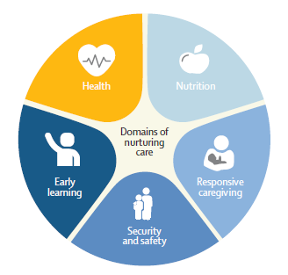
Parenting and nurturing care
Nurturing care is what the infant’s brain expects and depends upon for healthy development
Comprises:
Nutrition
Health care
Love and security
Responsive care
Opportunities to learn and discover the world
(Source: The LANCET Series, 2016)

Slide 12
The ecological model of nurturing care
National Policies
Integrated Services
ECE care in nurturing environment
Family and caregiver support
Health, nutrition, education, social and child protection services
Capacity to provide nurturing care
Nurturing care by parents and caregivers

Slide 13
Factors that hamper nurturing care
Extreme poverty and struggle for survival
Young parenthood
Family violence and maternal depression
Disability

Slide 14
Making nurturing care happen – Laws/policies/services
Income support – cash transfers/social welfare/family health insurance
Paid parental leave
Universal and quality health care
Multiple micronutrient supplementation for at risk children
Birth registration – entitlement to legal rights
Affordable child care services and WASH facilities
Free and compulsory pre-primary education

Slide 15
Making nurturing care happen – Multi sectoral packages
Family Support & Strengthening Package
Access to quality services, skills building, support
Multigenerational Nurturing Care Package
Care and protection of mothers’ and fathers’ physical and mental health and wellbeing, and their capacity to provide nurturing care
Early Learning & Protection Package
Integrates support for young children with parental and caregivers’ support to create a nurturing learning environment

Slide 16
Effective interventions – Tour of programs

Slide 17
Common features of large-scale programs
Political concerns about poverty, equity, social exclusion
Informed by scientific and economic evidence
Vision of comprehensive and integrated services
Founded by statute or government strategy
Funded and led by government
Different entry points – most often health, starting from pregnancy

Slide 18
Contextualizing the interventions
Context really matters, and understanding context and what risk children are exposed to in that context is highly important in deciding what interventions are needed and for which populations
Think about the existing platforms available
Combine interventions through a common delivery agent – common training and/or monitoring pathways

Slide 19
Example of Colombia
Goal: to integrate parenting and nutrition into a conditional cash transfer program that exists all over Colombia and targets the poorest 20% of households.
Mother volunteers in every community were identified to deliver new interventions that would strengthen children's development within those poorest households, delivering micronutrient supplementation and advising mothers with children under two years of age about how to stimulate their child, how to better interact, communicate with, and play with their child.
At the end of the evaluation, which was conducted through a randomized controlled trial, it was found that by strengthening the conditional cash transfer, children's cognitive and language development improved

Slide 20
Example of Chile
Goal: enable children to reach their potential
Implemented in 2007, came into law in 2009
Funded by federal government
Combines health services, parenting support and preschool
Universal and targeted services
From pregnancy to age 4
Scale – reaches 80% of target population

Slide 21
Example of India
India’s Integrated Child Development Services, one of the largest ECD program
Goal: promote early development of children from economically disadvantaged backgrounds
Implemented in 1975 and funded by the government
Combines health services, parenting support and preschool through a network of community centers

Slide 22
Example of Bangladesh
Bangladesh’s child development centers (Shishu Bikash Kendra); a PPP model to support young children with disabilities
Implemented in 2008
Establishment of SBK centers with trained physicians, therapists and psychologists within key public hospitals across the country
Provides a range of free services to poor families to reach at-risk children from birth through adolescence
Between 2009 to 2016, 2 lac children visited 15 SBKs showing improvement on follow up

Slide 23
Example of Pakistan
The LEAPS Programme: Community Youth Leaders Championing Early Childhood.
Run by the CYL in 2 groups per day (3.5 to 4.5 year olds and 4.6-5.5 year olds at the time of enrolment) each lasting 3 hours for 5 days per week.
Enrolled children were expected to stay for at least 1 year and transition to primary school when assessed as ‘ready.’
Significant improvements in child school readiness and child health, hygiene and nutrition knowledge and practice scores.

Slide 24
The way forward

Slide 25
Recommendations
Science says “start early,” conception-3y
Expand political will through the SDGs
Create conducive policy environments
Adopt a multi-sectoral framework
Use the health sector as an entry point
Support system enablers

Slide 26
Focus on children from conception to age 3
Heightened susceptibility
Neglect in favour of child survival and pre-primary education
Opportunities for interventions through health services

