Slide 1



Critical Role of first 1000 days in a child’s life
Dr. Naeem Zafar
M.B.B.S., D.C.H., F.C.P.S. Pediatrics
Head, Child Rights Department, The University of Lahore
President, PAHCHAAN (Protection and Help of Children Against Abuse and Neglect)
Convener CRC-PPA (Child Rights Committee, PPA)

Slide 2



The Critical “Window of Opportunity”:
1000 DAYS
Pregnancy: 9*30= 270 days
2 years: 365*2=730 days
Notes:
Quickly tell what its about including the need for protection of every child
2

Slide 3
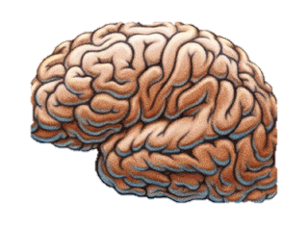
Why Early Experiences Matter
Newborn Brain
Average Weight
333 grams
2 Year Old’s Brain
Average Weight
999 grams
Adult Brain
Average Weight
1400 grams
Brain photo courtesy Isaac Mao, Flickr
Notes:
Work in neuroscience, molecular biology, and genomics tells us the following:
Before the age of 5. It takes less time, intensity and repetition to organize the developing neural systems than it does to reorganize already-developed neural systems
Early relationships, environments, and experiences affect all aspects of a child’s development
Nurturing relationships with parents/caregivers in the early years are critical
The first 1000 days from pregnancy to 2 years is a time period that can have a profound impact on a child’s growth and development
Toxic stress has a negative impact on a child’s development. Significant adversity can produce physiological disruptions or biological “memories” that can undermine the development of the body’s stress response systems and affect the developing, brain, cardiovascular system, immune system and metabolic regulatory controls
Early interventions are critical for optimal life course outcomes because these physiological disruptions can persist far into adulthood and lead to lifelong impairments in both physical and mental health

Slide 4
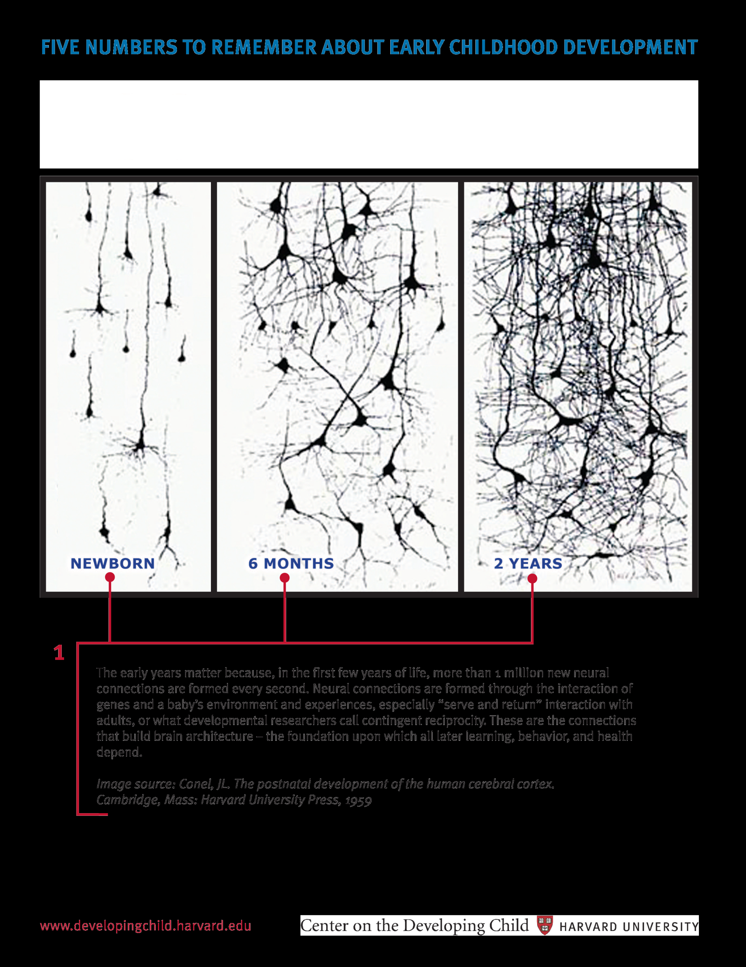
+1,000,000 MORE THAN 1 MILLION NEW NEURAL CONNECTIONSPER SECOND

Slide 5
Videos from Center on Developing Child Harvard University
Notes:
Quickly tell what its about including the need for protection of every child
5

Slide 6
Life course consequences of poor maternal and child undernutrition (MCU)
Long term
Short term
Brain
development
Cognitive and
educational
performance
Poor nutrition
in uterus
and early
childhood
(STUNTING)
Immunity
Work Capacity
Growth and muscle mass
Body composition
Diabetes, Obesity
Heart Disease
High blood pressure
Cancer, stroke,
and ageing
Metabolic Syndrome:
programming of metabolism
of glucose, lipids, protein
Hormone/receptor/gene
Death
(James et al 2000)
Notes:
This slide comes from The Report of the Commission for Nutrition in the first decade of the millennium prepared for the ACC/SCN. The commission was chaired by Prof P James.
It shows how inadequate fetal and infant growth can lead to four main areas of negative consequences.
One is death, since one half of child deaths have under nutrition as an underlying cause,, i.e. they would not have died from the infection if they had been better nourished.
The second is that brain development is affected, leading to long tern damage to cognitive and educational performance (increased school repetition rates etc).
The third is that the size of the body is compromised (stunting) and tissue development impaired such that work capacity is reduced as is immune capacity.
The fourth area of consequence is that of metabolic programming to cope with a resource scarce environment, (the thrifty phenotype) which leads to all the chronic degenerative disease of adulthood, including obesity.

Slide 7
Risk Factors
Poverty and associated health, nutrition, and social factors prevent at least 200 million children in developing countries from attaining their developmental potential.
We identify four key risk factors where the need for intervention is urgent: stunting, inadequate cognitive stimulation, iodine deficiency, and iron deficiency anemia.
The evidence is also sufficient to warrant interventions for malaria, intrauterine growth restriction, maternal depression, exposure to violence, and exposure to heavy metals.
Furthermore, risks often occur together or cumulatively, with concomitant increased adverse effects on the development of the world's poorest children.
1- Walker SP, Wachs TD, Gardner JM, Lozoff B, Wasserman GA, Pollitt E, Carter JA; International Child Development Steering Group. Child development: risk factors for adverse outcomes in developing countries. Lancet. 2007;369(9556):145-57.

Slide 8
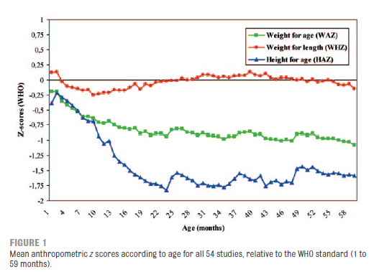
Stunting is preventable : BUT
Need to act before the child is 2 years
Notes:
Quickly tell what its about including the need for protection of every child
8

Slide 9

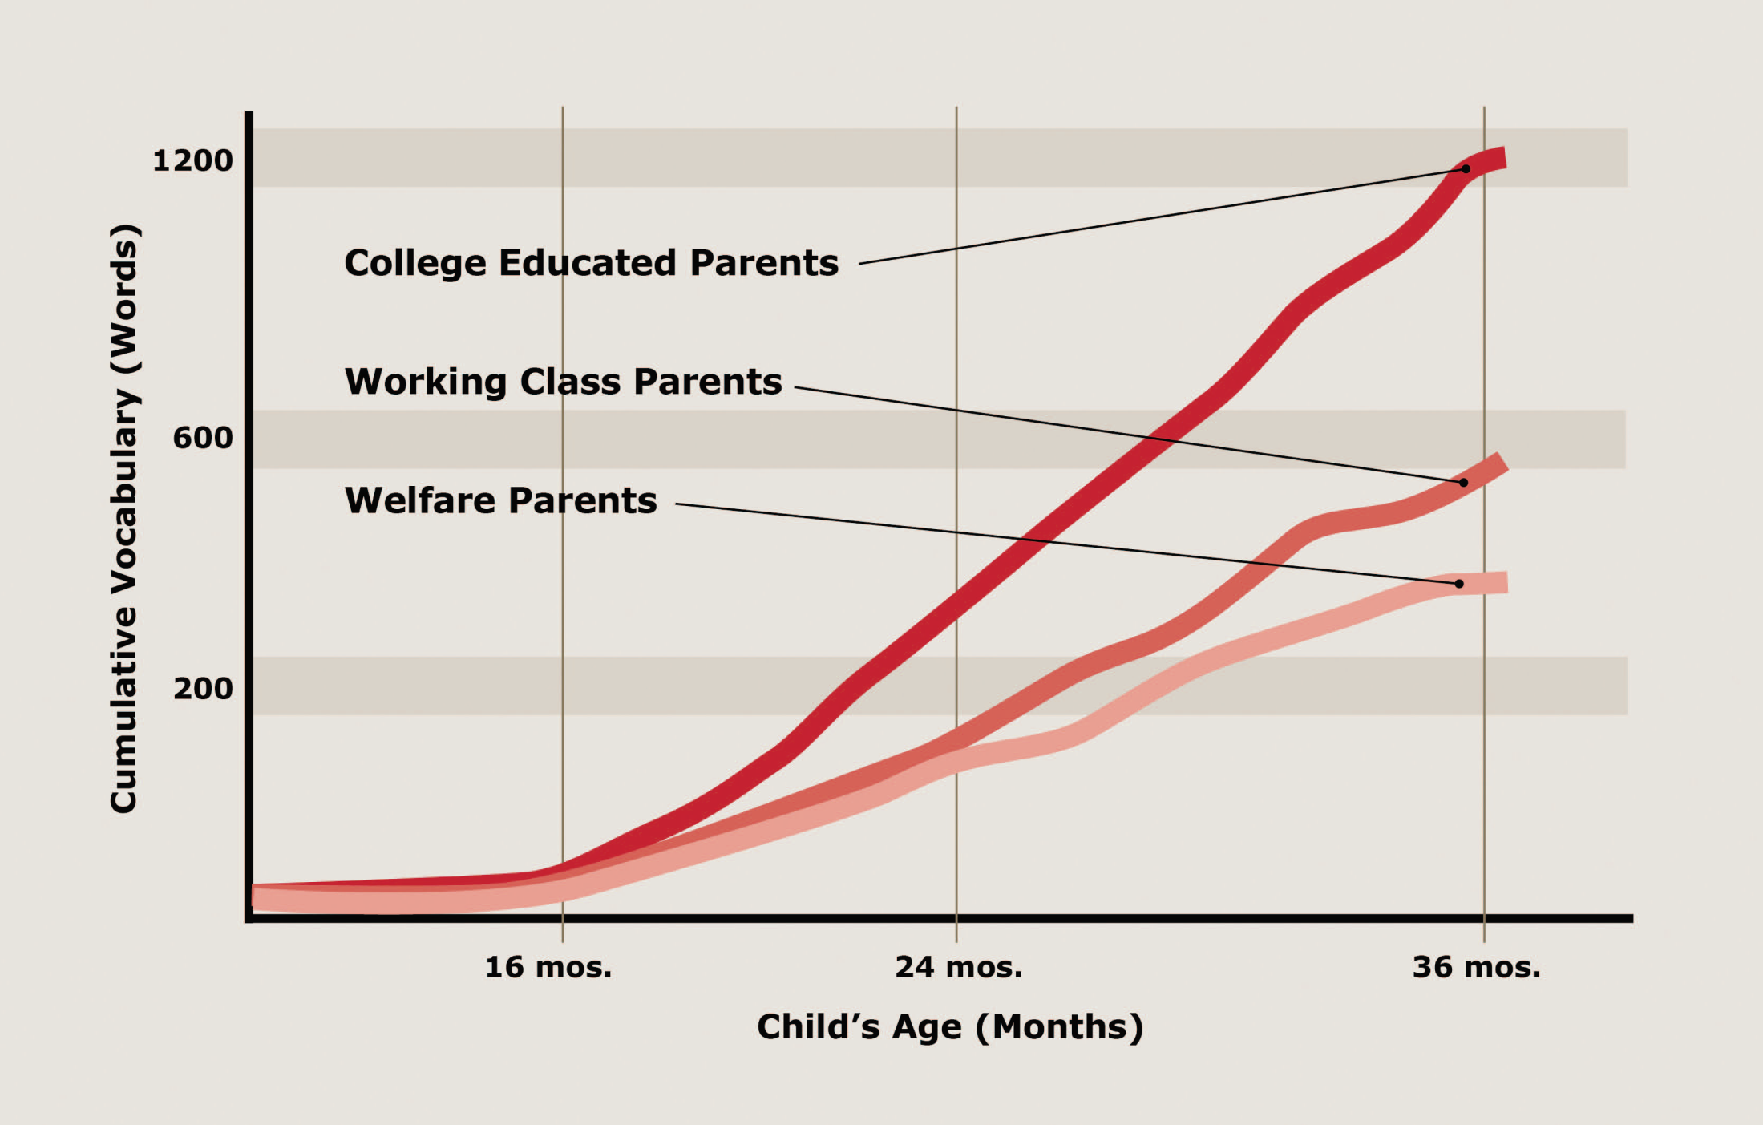

Slide 10

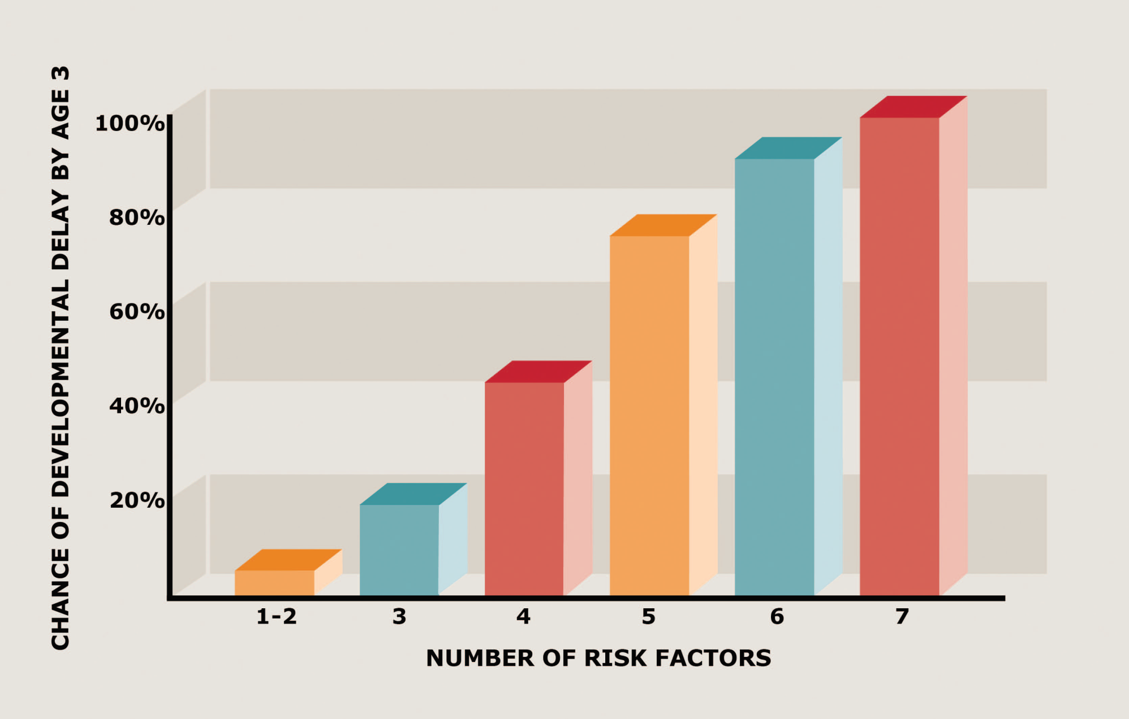

Slide 11

Notes:
Quickly tell what its about including the need for protection of every child
11

Slide 12
A compelling investment
Children who get the right nutrition during the first 1000 days:
o Are 10 times more likely to overcome the most life threatening child diseases
o Complete 4.6 more grades at school
o Go on to earn 21% more in wages as adults
o Are more likely as adults to have healthier families
Notes:
Quickly tell what its about including the need for protection of every child
12

Slide 13
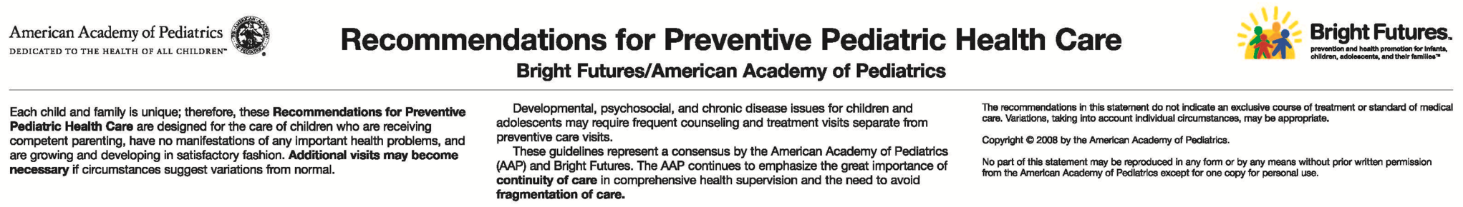
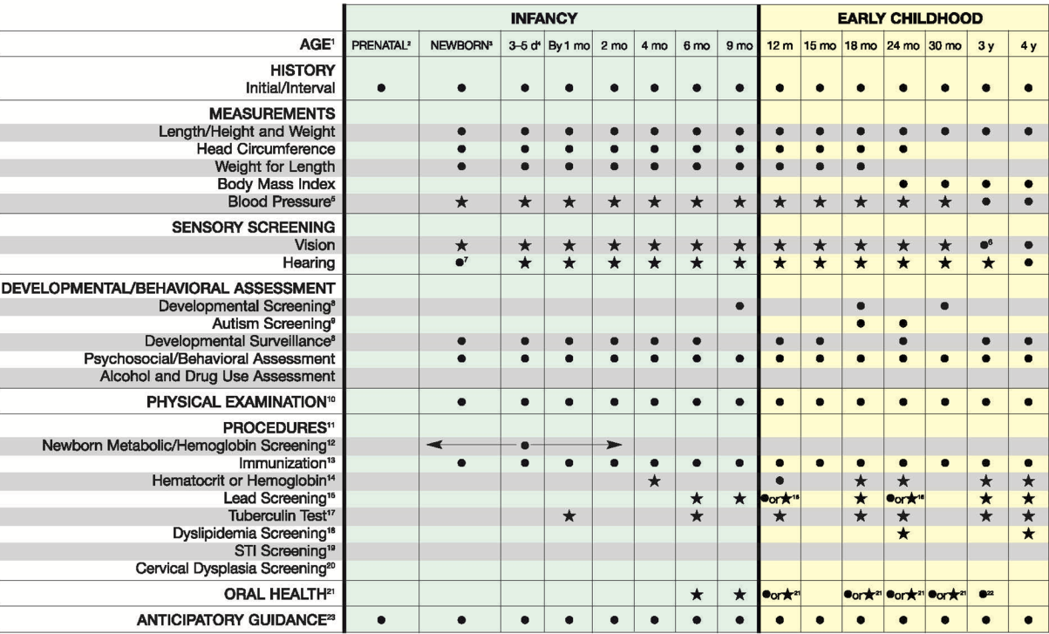
Notes:
The AAP’s periodicity schedule for recommended preventive health care services provides several opportunities for primary care pediatricians to promote early brain development as well as assess for developmental, behavioral and social-emotional concerns.
This graphic from the American Academy of Pediatrics, Committee on Practice and Ambulatory Medicine and Bright Futures Steering Committee’s recommendations for preventive pediatric health care shows some of the EBCD related items that are already taking place such as lead screening psychosocial and behavioral assessments etc.
Source: American Academy of Pediatrics, Committee on Practice and Ambulatory Medicine and Bright Futures Steering Committee. Recommendations for preventive pediatric health care. Pediatrics. 2007;120(6):1376

Slide 14
Tips for Pediatricians
Key Points
§§ To evaluate social-emotional health during your busy day, choose a screening tool that can be easily incorporated into the office workflow.
§§ During the examination be sure to observe the relationship between the parent and child. Is it appropriate?
§§ Through early intervention, primary care providers can make a difference in the overall success in life of all children at an early age and improve their physical and mental health outcomes.
§§ If there are behavioral concerns, refer to an early childhood mental health specialist in your community.
Notes:
Quickly tell what its about including the need for protection of every child
14

Slide 15
Tips for Pediatricians
Key Points
§§ Consider the child’s biology and foundations for healthy
development and how toxic stress may impact them.
§§ Recognize the role the pediatrician has in supporting
the healthy foundations.
§§ It is critical to identify and address the concerns when a child’s foundation of healthy development is less than desirable.
Notes:
Quickly tell what its about including the need for protection of every child
15

Slide 16
Tips for Pediatricians
Key Points
§§ Incorporate questions into your exam routine to identify possible stressors or mental health issues.
§§ Look beneath the surface for the less visible signs of social emotional difficulties.
§§ Screening is the first step—referrals to appropriate treatment is key.
Notes:
Quickly tell what its about including the need for protection of every child
16

Slide 17
Promote the Five R’s of Early Childhood Education
Reading together as a daily family activity
Rhyming, playing, talking, singing and cuddling together often
Routines and regular times for meals, play and sleeping, which help children know what they can expect and what is expected of them
Rewards for everyday successes, realizing that praise from those closest to a child is a very potent reward
Relationships that are reciprocal, nurturing and enduring are the foundation of healthy child development
Notes:
What can you do? Help promote the Five R’s of early childhood. These may seem simple, but implementing these behaviours and approaches at home can have profound consequences for children’s lives. For example, daily reading together and regular bedtime were two practices found in the most “successful” families in one study. (Source (GIVE FULL CITE): The Millennium Cohort Study, 2010.)

Slide 18

It is easier to build strong children than to repair broken men.
Frederick Douglass

Slide 19
Notes:
Quickly tell what its about including the need for protection of every child
19

Slide 20
Notes:
Quickly tell what its about including the need for protection of every child
20

Slide 21
Notes:
Quickly tell what its about including the need for protection of every child
21

Slide 24
Notes:
Quickly tell what its about including the need for protection of every child
24

Slide 25
Notes:
Quickly tell what its about including the need for protection of every child
25

Slide 26
Notes:
Quickly tell what its about including the need for protection of every child
26

Slide 27
Notes:
Quickly tell what its about including the need for protection of every child
27

Slide 28
Notes:
Quickly tell what its about including the need for protection of every child
28

Slide 29
Notes:
Quickly tell what its about including the need for protection of every child
29

